Slide 1
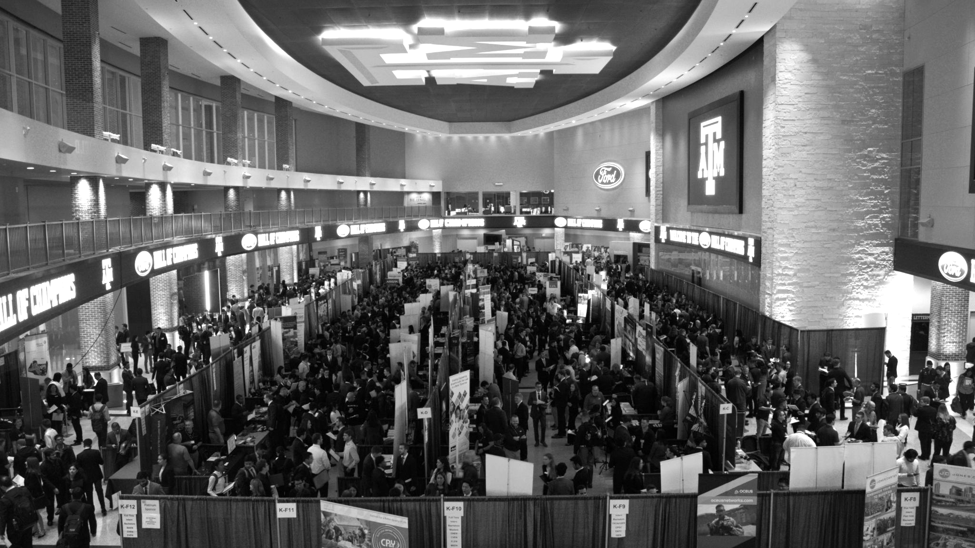

LANL Team Update
10/23/2024
Izzy Baumler, Dalton Boeckmann, Morgan Gullo, Jade Waldron

Slide 2
Mission Statement
There should be such a technology that has 6 DOF and can move through its full range of motion in each degree of freedom at 1 Hz.
Constraints:
Degrees of freedom
Workspace
Weight
Strength
Speed of movement

Slide 3
Weekly Updates
Finishing DR2 Report
Concept Refinement
Concept Selection
Preliminary CAD Model
Final edits
Scheduled final presentation on November 22nd

Slide 4
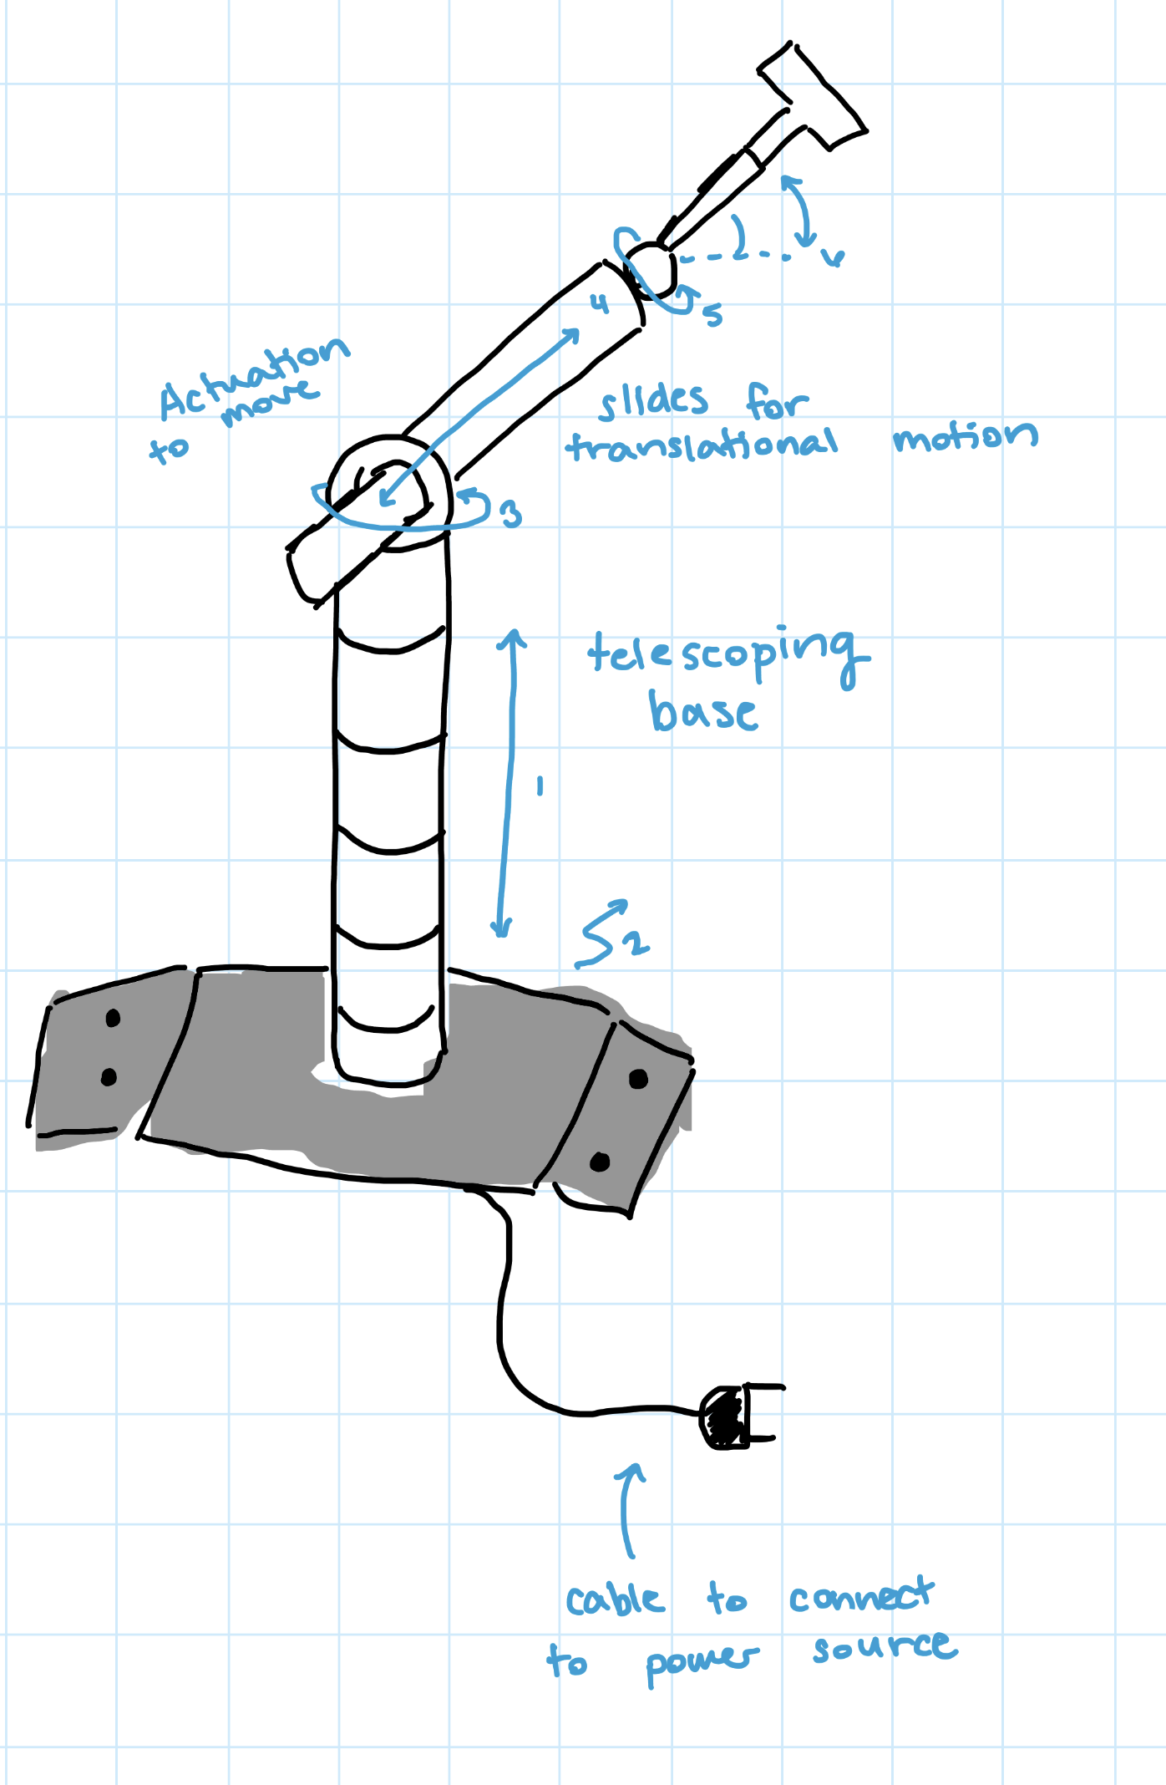
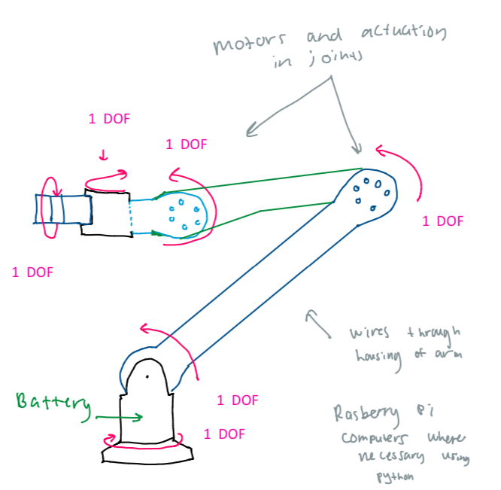
Concepts

Slide 5
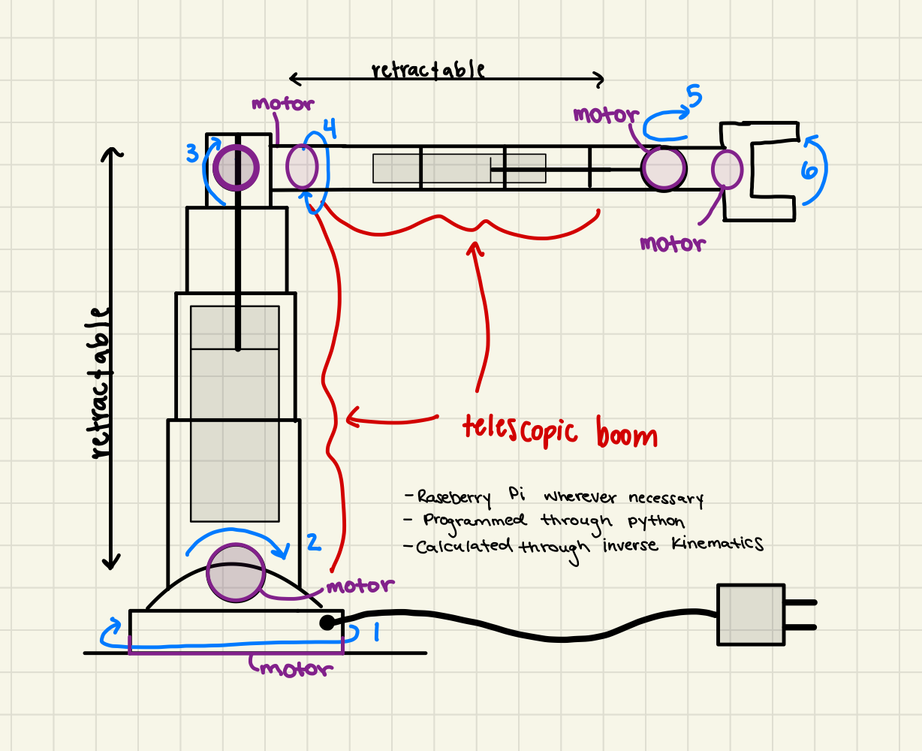
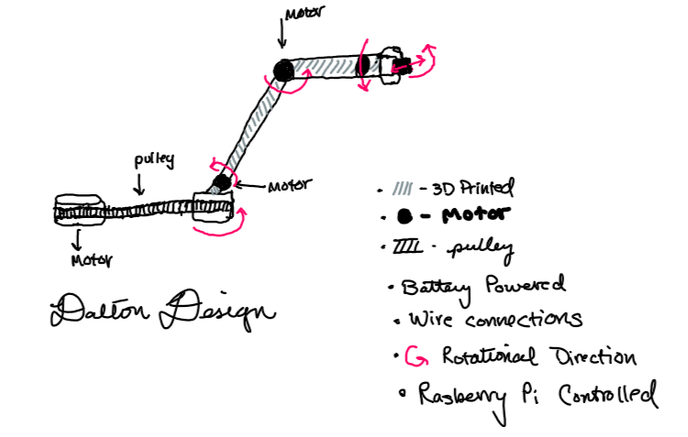
Concepts

Slide 6
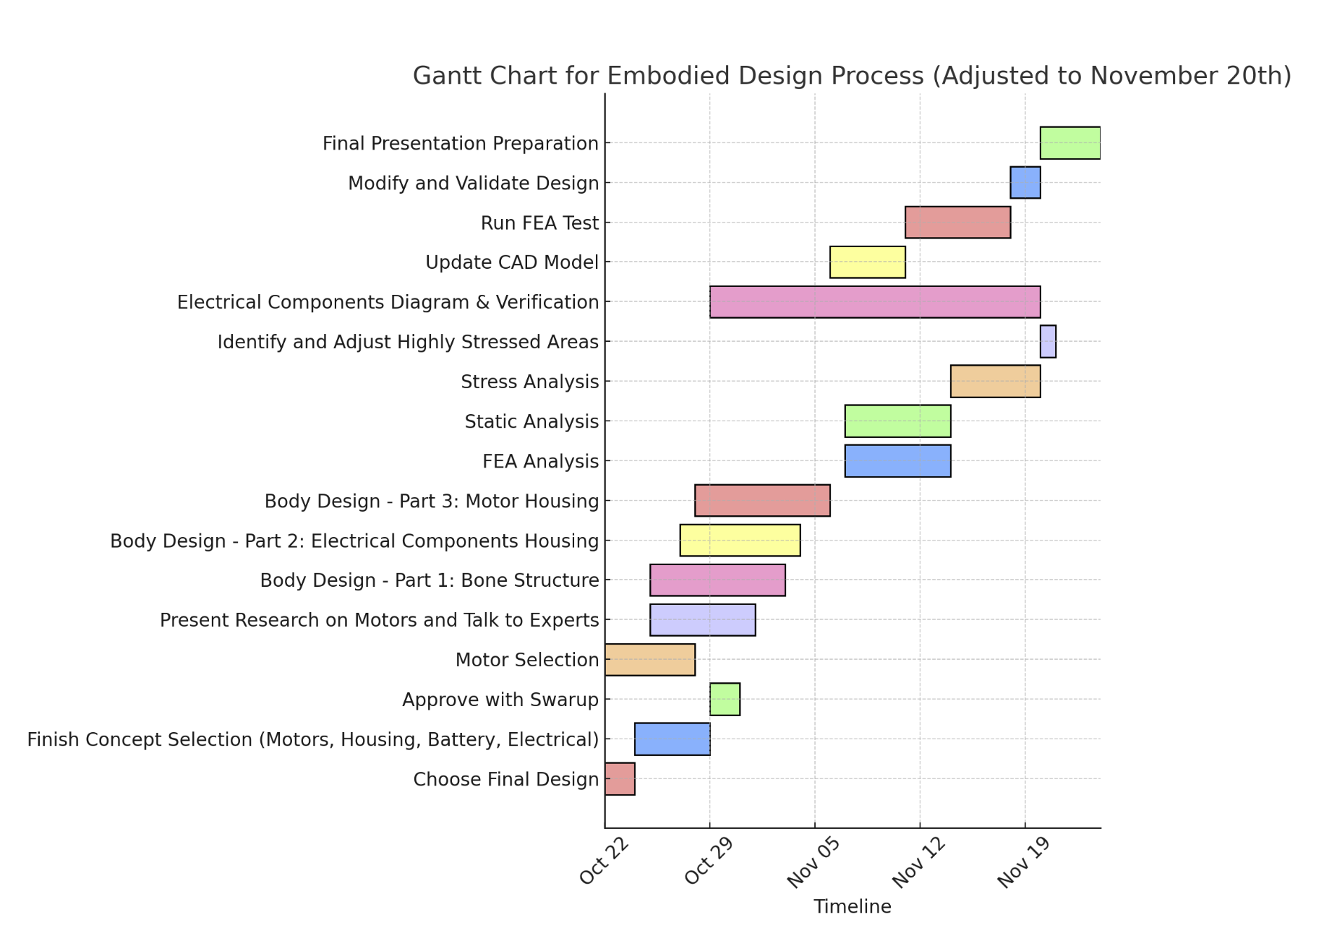
Planning for Embodiment Design Process
Organized a detailed Gantt chart for the embodiment design process, once we choose a final design
Planning to closely follow this schedule to ensure things are finished and validated

Slide 7
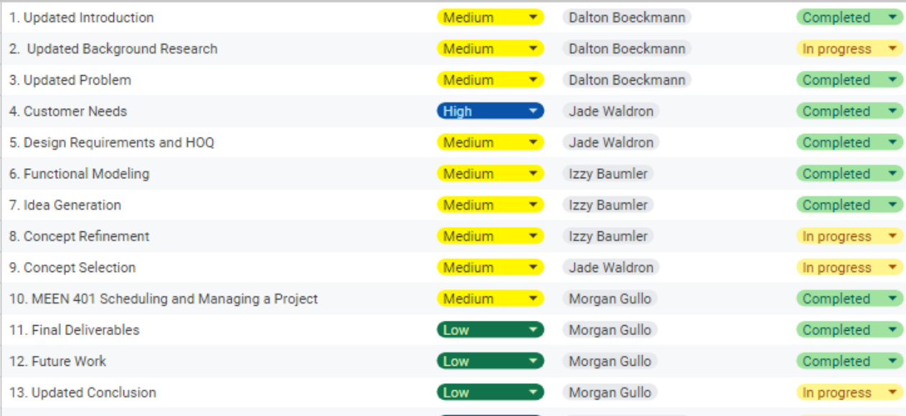
Schedule

Slide 8
Upcoming Week
Meeting with our Sponsor this Friday (10/25)
Continue following Embodiment design schedule
Finish DR2

